Slide 1


Java.IL Meetup
Spring Session
MAY 23/ TLV, Israel

Slide 2
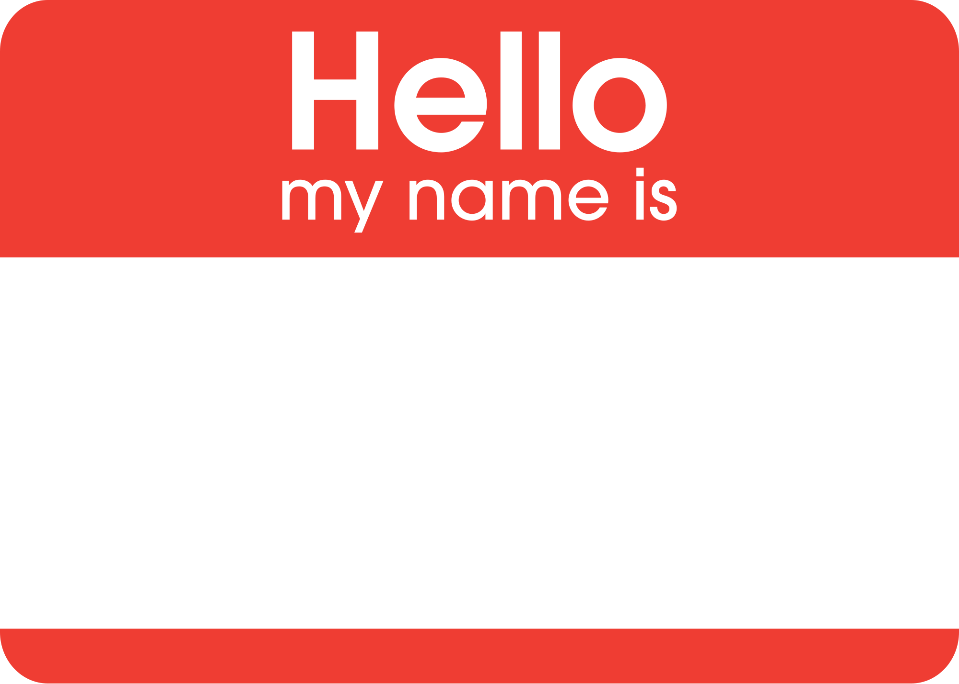

Elad Hirsch
Consultant @
MAY 23/ TLV, Israel

Slide 3


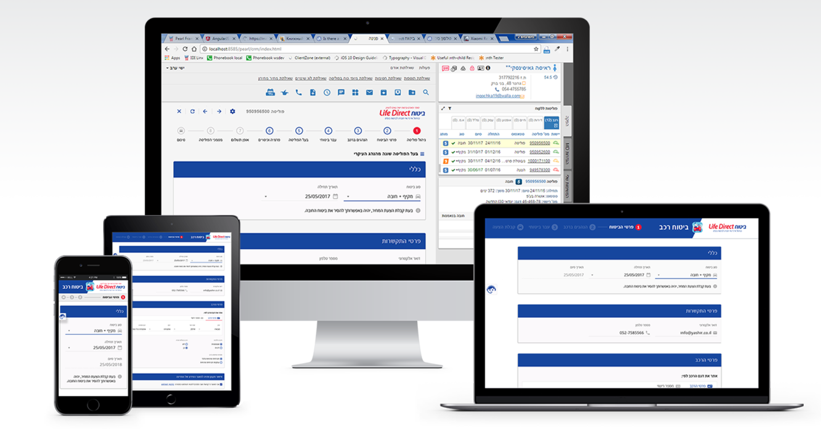

Slide 4

Challenges managing application state

Slide 5

Multiple session state protocols
HttpSession, WebSockets and WebSession
Session security threats
CSRF, Cookie hijacking , Session fixation
Session High Availability

Slide 6

Spring session

Slide 7
A Common Abstraction for Session State Management

Slide 8
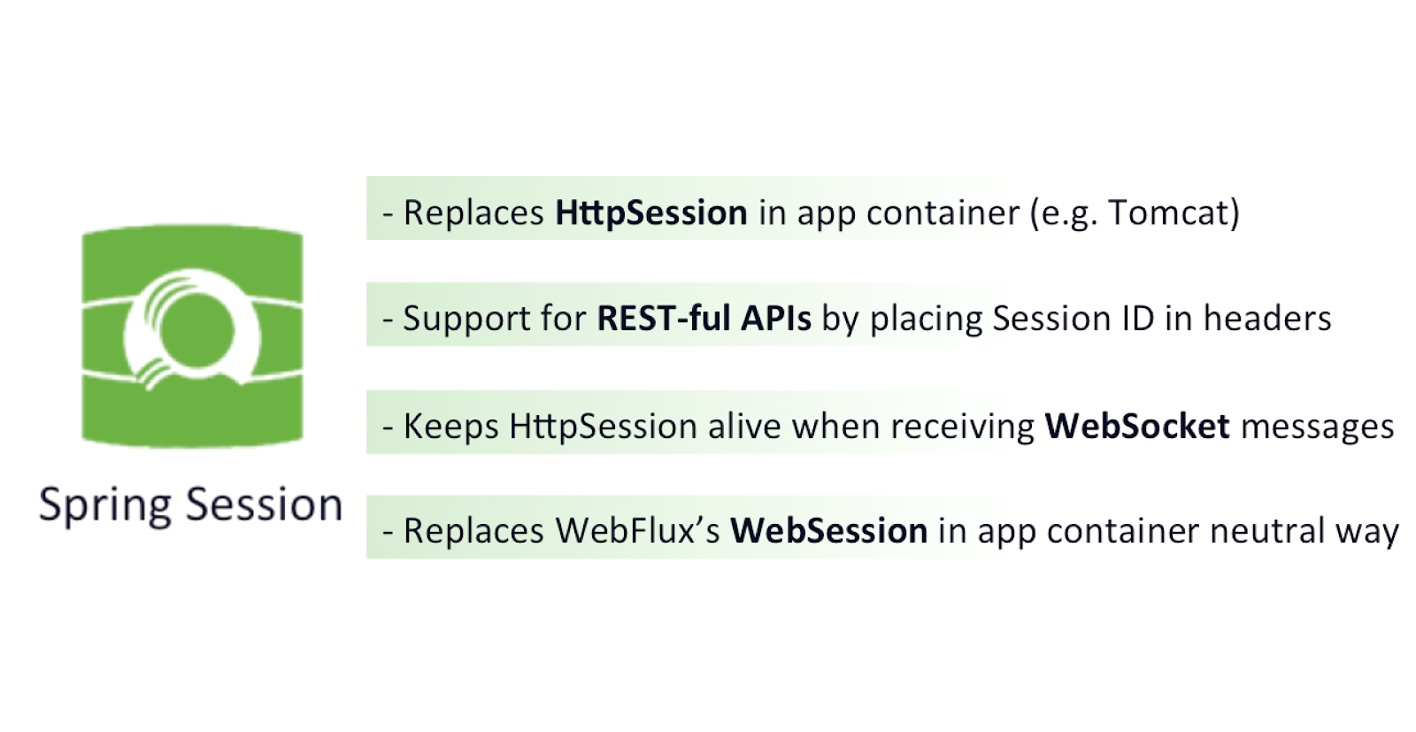

Slide 9
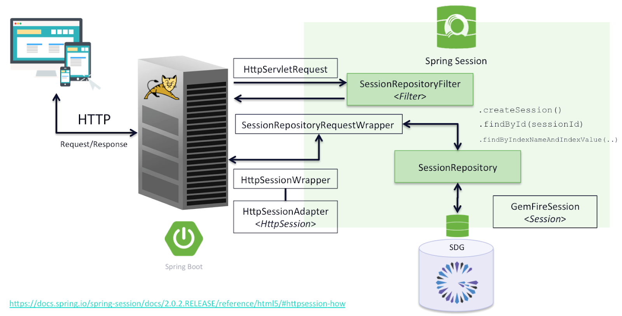

Slide 10


Slide 16

Find Session (query based)
Custom Serialization
Spring Security Integration
Multiple Browser Sessions

Slide 17
Scaling and High Availability
Replicate session data across multiple peers
Partition data across multiple servers
Optimizations:
Send only delta/diff
Share/replicate session by physical location

Slide 18




Session management
http://localhost:8080/swagger-ui.html
http://localhost:9090/swagger-ui.html

Slide 19
Working with the Session

Slide 20
What about Session Security ?

Slide 21
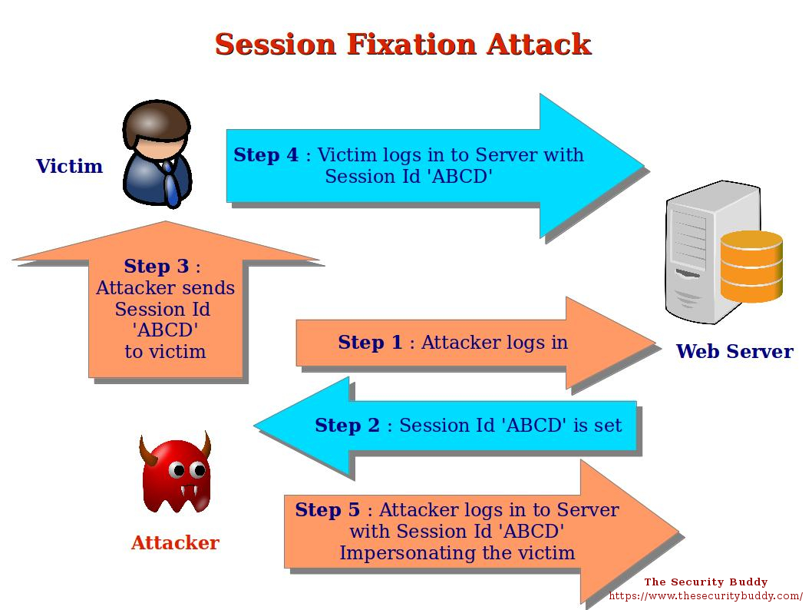

Slide 22
Session AuthenticationStrategy
Copy session data Create new session
+

Slide 23
Always – always create session
ifRequired – if requested
Never - use if exists
Stateless - no session at all

Slide 24
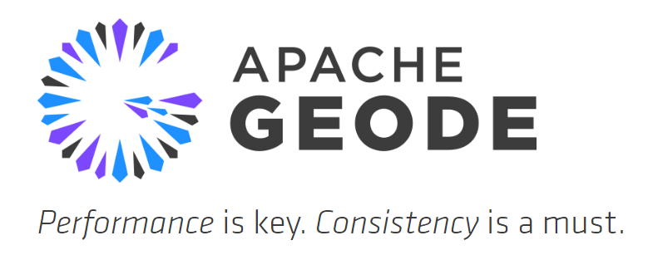
Cloud based session replication

Slide 25
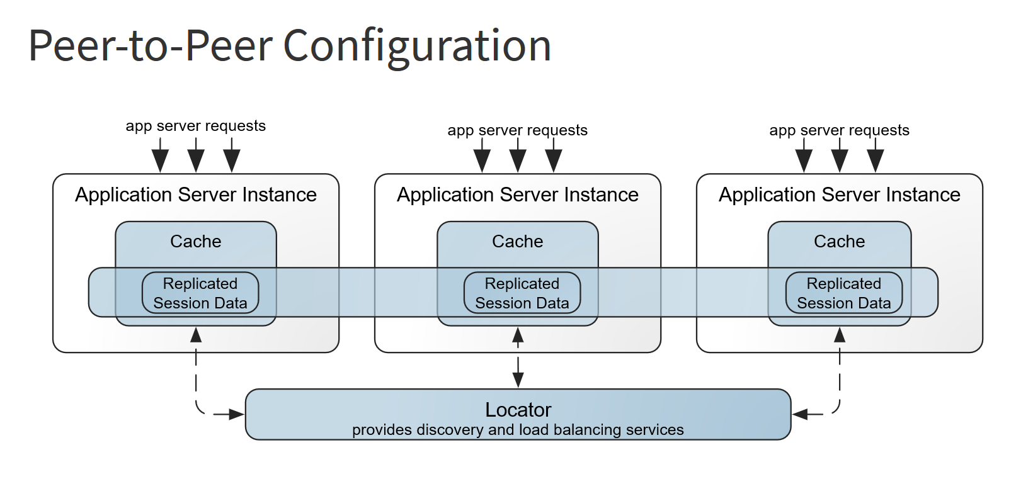

Slide 26
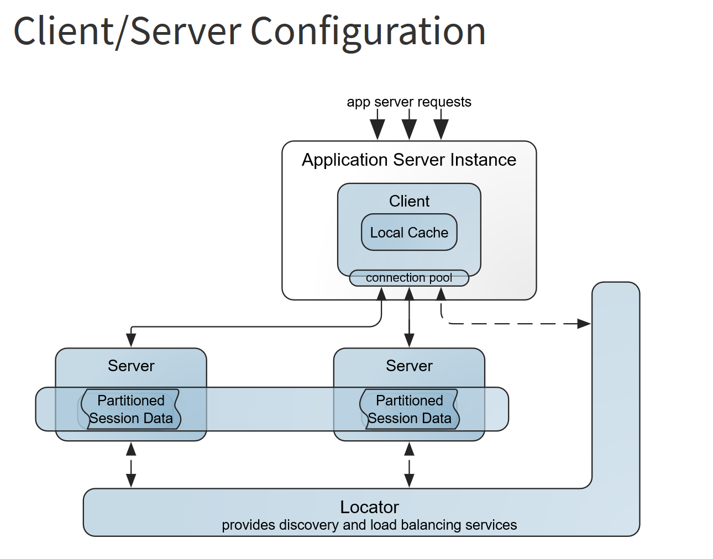

Slide 27
_{Demo}
_{https://github.com/eladh/....}
MAY 23/ TLV, Israel

Slide 28

_{Thank you!}
Elad Hirsch
Consultant @ Trainlogic
https://il.linkedin.com/in/eladhirsch
MAY 23/ TLV, Israel

